Slide 1
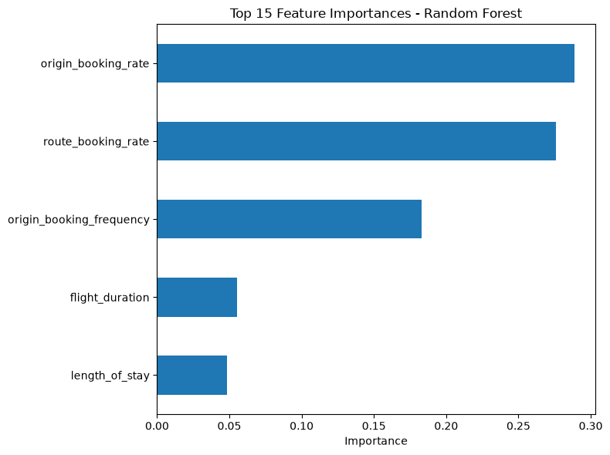
Model: Random Forest classifier, validated with 5-fold cross-validation for reliability.
Recall (bookers correctly identified): ~79%
Precision: ~29%
Consistent performance across all 5 validation folds (low variance)
Note: accuracy alone will not work here - only 15% of customers complete bookings, so we optimized to catch as many likely bookers as possible.
Booking completion is driven by historical route and origin conversion rates.
Trip characteristics has comparatively minor influence. On my openion, market/route-level targeting may be more effective than behaivior based targeting alone.
Notably, using only the route origin and origin conversion rate features alon achievies nearly identical performance to the full model, without any data or information leakage between training and testing dataset.
Recommendation: Prioritize marketing spend toward customers from historically high converting booking origins and routes. While further data about customer background could add more value and imrpove the model peformance

